Slide 1
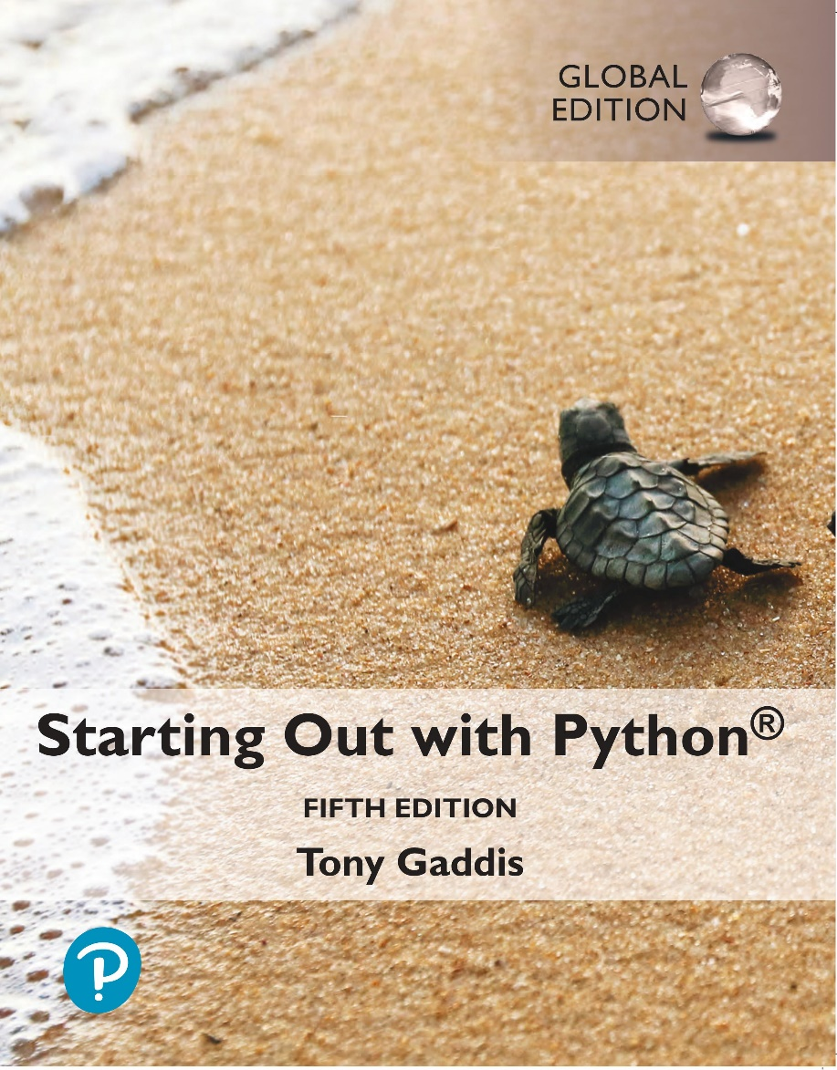
Starting out with Python
Fifth Edition, Global Edition
Chapter 7
Lists and Tuples
Copyright © 2022 Pearson Education, Ltd. All Rights Reserved.

Slide 2
Topics
List Comprehensions
Two-Dimensional Lists
Tuples

Slide 3
List Comprehensions (1 of 7)
List comprehension: a concise expression that creates a new list by iterating over the elements of an existing list.

Slide 4
List Comprehensions (2 of 7)
The following code uses a for loop to make a copy of a list:
The following code uses a list comprehension to make a copy of a list:
list1 = [1, 2, 3, 4]
list2 = []
for item in list1:
list2.append(item)
list1 = [1, 2, 3, 4]
list2 = [item for item in list1]

Slide 5
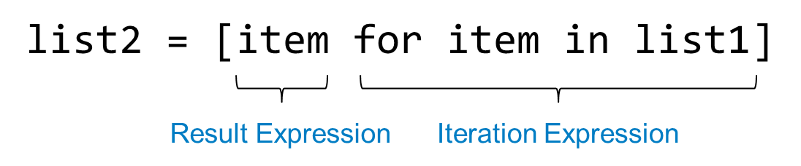
List Comprehensions (3 of 7)
The iteration expression works like a for loop
In this example, it iterates over the elements of list1
Each time it iterates, the target variable item is assigned the value of an element.
At the end of each iteration, the value of the result expression is appended to the new list.

Slide 6
List Comprehensions (4 of 7)
list1 = [1, 2, 3, 4]
list2 = [item**2 for item in list1]
After this code executes, list2 will contain the values [1, 4, 9, 16]

Slide 7
List Comprehensions (5 of 7)
str_list = ['Winken', 'Blinken', 'Nod']
len_list = [len(s) for s in str_list]
After this code executes, len_list will contain the values [6, 7, 3]

Slide 8
List Comprehensions (6 of 7)
You can use an if clause in a list comprehension to select only certain elements when processing a list
list1 = [1, 12, 2, 20, 3, 15, 4]
list2 = []
for n in list1:
if n < 10:
list2.append(n)
Works the same as…
list1 = [1, 12, 2, 20, 3, 15, 4]
list2 = [item for item in list1 if item < 10]

Slide 9
List Comprehensions (7 of 7)
list1 = [1, 12, 2, 20, 3, 15, 4]
list2 = [item for item in list1 if item < 10]
After this code executes, list2 will contain [1, 2, 3, 4]

Slide 10
Two-Dimensional Lists (1 of 3)
Two-dimensional list: a list that contains other lists as its elements
Also known as nested list
Common to think of two-dimensional lists as having rows and columns
Useful for working with multiple sets of data
To process data in a two-dimensional list need to use two indexes
Typically use nested loops to process

Slide 11
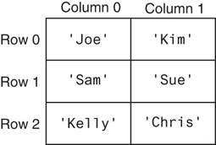
Two-Dimensional Lists (2 of 3)
Figure 7-8 A two-dimensional list

Slide 12
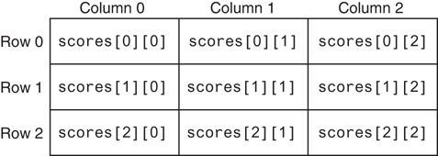
Two-Dimensional Lists (3 of 3)
Figure 7-10 Subscripts for each element of the scores list

Slide 13
Örnek
Soru: 1-10 arasında kodlanmış 10 satıcının çalıştığı bir mağazada haftanın 7 günü boyunca satıcıların her yaptığı satış için satıcı kodu ve satış tutarı verilerini alan, satıcıların günlük satış toplamlarını, mağazanın satıcı ve gün bazında satış toplamlarını ve haftalık satış toplamını bulan algoritma:

Slide 14
Örnek
Soru: Kare matrisler ile ilgili çeşitli işlemler

Slide 15
Tuples (1 of 3)
Tuple: an immutable sequence
Very similar to a list
Once it is created it cannot be changed
Format: tuple_name = (item1, item2)
Tuples support operations as lists
Subscript indexing for retrieving elements
Methods such as index
Built in functions such as len, min, max
Slicing expressions
The in, +, and * operators

Slide 16
Tuples (2 of 3)
Tuples do not support the methods:
append
remove
insert
reverse
sort

Slide 17
Tuples (3 of 3)
Advantages for using tuples over lists:
Processing tuples is faster than processing lists
Tuples are safe
Some operations in Python require use of tuples
list() function: converts tuple to list
tuple() function: converts list to tuple

Slide 18
Summary
This chapter covered:
Lists, including:
Two-dimensional lists
Tuples, including:
Immutability
Difference from and advantages over lists

